Slide 1
Object Oriented Programming with Java
Tin Bui Huy
July 2012

Slide 2
Agenda
OOP
Nested Classes
Anonymous Classes
Access Specifiers and Modifiers
Method
Enum
Generic
Annotation

Slide 3
Agenda
Event Handling
Exceptions
I/O Streams
Multi-threading
Java Conventions
Javadoc
Collection
Reflection

Slide 4
Object Oriented Programming
Refers Object Oriented Programming.ppt
  Encapsulation
  Inheritance
  Abstraction
  Polymorphism

Slide 5
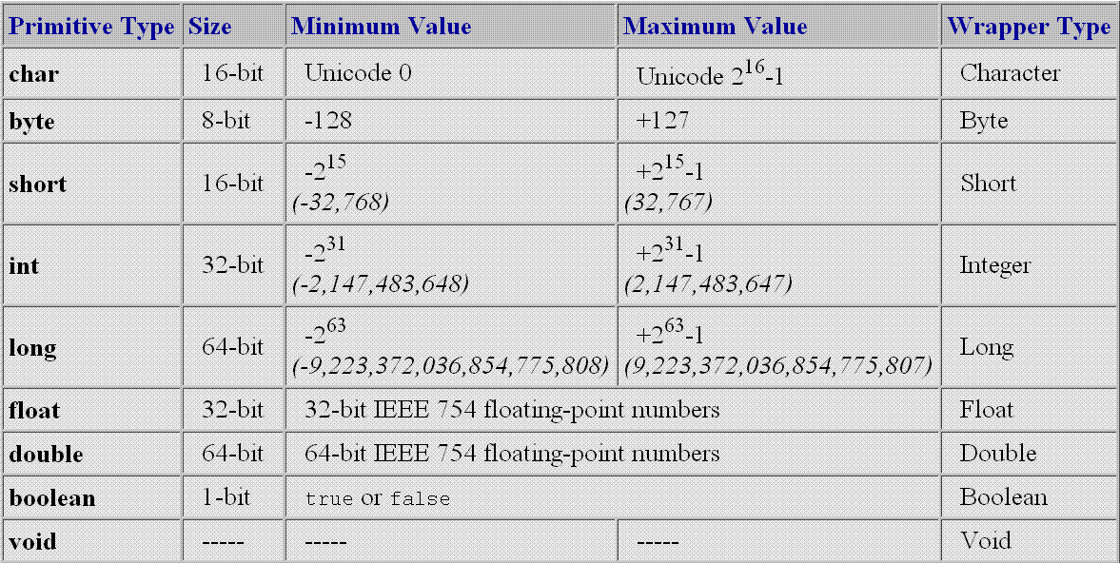
Primitive data type
Every data type in java is class except:

Slide 6
Nested Classes
Class defined inside another class or its method
  Inner class can access members of the outer class's instance
<OuterClass>.this
  Access this pointer of the outer class when you are in the inner class
static
  Use this modifier to make the inner class accessible outside the outer class
final
  This modifier must be used for method's variables or params accessed by its inner classes

Slide 7
Inner Class Example
void createForm(final int formType) {
JButton b = new JButton();
final String aMessage = "Hi!";
class ClickActionListener implements ActionListener {
public void actionPerformed(ActionEvent e) {
System.out.println(aMessage + formType);
}
}
b.addActionListener(new ClickActionListener());
}
static class ClickActionListener2 implements ActionListener {
public void actionPerformed(ActionEvent e) {
System.out.println("Hi!");
}
}

Slide 8
Anonymous Class
Name of the interface or super class of this class
A class defined inline without name
void createForm2(final int formType) {
JButton b = new JButton();
b.addActionListener(new ActionListener() {
public void actionPerformed(ActionEvent e) {
System.out.println("Clicked me!");
}
});
}

Slide 9
Access Specifiers and Modifiers
final
  Used for class, fields, methods, parameters or variables
static
  Used for inner class, members
  Static initialization block: used to deal with static stuffs
abstract
native
synchronized
...

Slide 10
Initialization Blocks
class SmallInit {
static int x;
int y;
static { x = 7 ; } // static init block
{ y = 8; } // instance init block. When???
}

Slide 11
Initialization Blocks
Another example:
public class ModifierTest {
static public final int[] CONST_ARRAY;
static public String status;
static {
CONST_ARRAY = new int[3];
CONST_ARRAY[0] = 0;
CONST_ARRAY[1] = 1;
CONST_ARRAY[2] = 2;
if (anotherStaticCondition) {
status = "Suscess!";
} else {
status = "Error!";
}
}
}

Slide 12
Method
main() method is a method
Java always pass by value
  For reference types it is the address of the passed object
Side effect
  Change value of a reference
...: variable argument
  Nearly the same as array argument

Slide 13
Method
class A {
JButton x = new JButton("Button x");
JButton y = new JButton("Button y");
JButton z = new JButton("Button z");
JButton t = new JButton("Button t");
public void change(JButton b1, final JButton b2, JButton b3) {
b1.setText("b1"); // affect
b2.setText("b2"); // same as above, final has no meaning!
b3 = new JButton("b3"); // no affect
t = new JButton("tt"); // affect
}
public static void main(String[] args) {
A a = new A();
a.change(a.x, a.y, a.z);
}
}

Slide 14
Variable Arguments
public static int sum(int... numbers) {
int total = 0;
for (int i = 0; i < numbers.length; i++) {
total += numbers[i];
}
return total;
}
public static void main (String[] arg) {
sum();
sum(5);
sum(5, 6, 7);
}

Slide 15
Enum
Basic enum
public enum Day {
SUNDAY, MONDAY, TUESDAY, WEDNESDAY,
THURSDAY, FRIDAY, SATURDAY
}

Slide 16
Enum
Advanced Enum
public enum Planet {
public Planet MERCURY (3.303e+23, 2.4397e6),
VENUS (4.869e+24, 6.0518e6),
EARTH (5.976e+24, 6.37814e6);
// universal gravitational constant (m3 kg-1 s-2)
public static final double G = 6.67300E-11;
public final double mass; // enum's member is usually final
public double radius;
Planet(double mass, double radius) {
this.mass = mass;
this.radius = radius;
}
public double surfaceGravity() {
return G * mass / (radius * radius);
}
public double surfaceWeight(double otherMass) {
return otherMass * surfaceGravity();
}
}

Slide 17
Enum
Use enum
public static void main(String[] args) {
Planet myPlanet = Planet.VENUS;
System.out.println("Mass: " + myPlanet.mass);
System.out.println("Gravity: " + myPlanet.surfaceGravity());
}

Slide 18
Enum
Can implement interfaces
Consist of a fixed set of constants
The enum declaration defines a class
Can include methods and other fields
Compiler automatically adds some special methods to enum
  e.g. values()
Note: All enums implicitly extend java.lang.Enum. Since Java does not support multiple inheritance, an enum cannot extend anything else.

Slide 19
Annotation
Annotation is metadata
Annotation is an @Interface
Each method declaration defines an element of the annotation type
Method declarations must not have any parameters or a throws clause
Return types are restricted to
  primitives, String, Class, enums, annotations,
  And arrays of the preceding types
Methods can have default values

Slide 20
Annotation Type Declaration
public @interface RequestForEnhancement {
int id();
String synopsis();
String engineer() default "unassigned";
String date(); default "unimplemented";
}

Slide 21
Annotation Usage
Example 1
@RequestForEnhancement(
id = 2868724,
synopsis = "Enable time-travel",
engineer = "Mr. Peabody",
date = "4/1/3007"
)
public static void travelThroughTime(Date destination) { ... }
Example 2
@Copyright("2002 Yoyodyne Propulsion Systems")
public class OscillationOverthruster { ... }

Slide 22
Annotation
Annotations do not directly affect program semantics
But they do affect the way programs are treated by tools and libraries, which can in turn affect the semantics of the running program
Annotations can be read from source files, class files, or reflectively at run time
Annotations complement javadoc tags
Annotation is widely used in many framework
  e.g. Spring

Slide 23
Java Convention
Refers JavaCodingConventions.ppt

Slide 24
Generic
Refer Java Generic Programming slides

Slide 25
Event Handling
Listen events
Fire events

Slide 26
Listen Events
JButton b = new JButton();
b.addActionListener(new ActionListener() {
public void actionPerformed(ActionEvent e) {
System.out.println("Button Clicked!");
}
});

Slide 27
Fire Event Steps
[Option] Define an event class extends EventObject
  This class contains the event source
[Option] Define an event listener interface extends EventListener
  This class declares which event(s) will be fired
Define your class that cause the event(s). This class must have these methods:
  public void add<YourEvent>Listener(<YourEvent>Listener l)
  public void remove<YourEvent>Listener(<YourEvent>Listener l)
  protected void fire<YourEvent1>()
  ...
  protected void fire<YourEventn>()

Slide 28
Raise Event - Example
Event object class
public class MyEventObject extends EventObject {
public MyEventObject(Object source) {
super(source);
}
}

Slide 29
Raise Event - Example
Event listener interface
public interface MyEventListener extends EventListener {
void myEvent1Happened();
void myEvent2Happened();
}

Slide 30
Raise Event - Example
Class which causes the event
public class Raiser {
private List<MyEventListener> myEventListeners
= new ArrayList<MyEventListener>();
public void addMyEventListener(MyEventListener l) {
myEventListeners.add(l);
}
public void removeMyEventListener(MyEventListener l) {
myEventListeners.remove(l);
}
protected void fireMyEvent1Happened() {
for (MyEventListener l : myEventListeners) {
l.myEvent1Happened();
}
}

Slide 31
Raise Event - Example
Class which causes the event (cont.)
protected void fireMyEvent2Happened() {
for (MyEventListener l : myEventListeners) {
l.myEvent2Happened();
}
}
public void aMethod() {
long time = System.currentTimeMillis();
if (time % 100 == 0) {
fireMyEvent1Happened();
}
if (time % 1000 == 0) {
fireMyEvent2Happened();
}
}
}

Slide 32
Raise Event - Example
Class listens to the event
public class Handler {
public Handler() {
Raiser r = new Raiser();
r.addMyEventListener(new MyEventListener() {
public void myEvent1Happened() {
System.out.println("Event1 happened");
}
public void myEvent2Happened() {
System.out.println("Event2 happened");
}
});
}
}

Slide 33
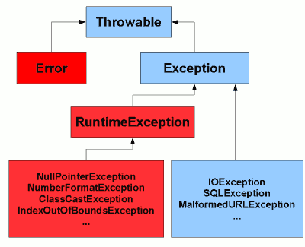
Java Exceptions Hierarchy

Slide 34
Rationale behind the hierarchy
Error subclasses
  Represent "serious" errors that a program generally shouldn't expect to catch and recover from
  E.g. expected class file being missing, OutOfMemoryError
Exception subclasses (except RuntimeException)
  Represent errors that a program can reasonably recover from
RuntimeException
  Shouldn't generally expect to occur, but could potentially recover from
  Likely to be programming errors rather than invalid user input or a badly configured environment
  E.g. ClassCastException, NullPointerException

Slide 35
Checked vs unchecked exceptions
Unchecked Exceptions
  The red ones in the picture
  Can be thrown "at any time"
  Methods don't explicitly have to declare them
  Callers don't have to handle them explicitly
Checked Exceptions
  The cyan ones in the picture
  Methods must explicitly declare them
  Callers have to handle them explicitly

Slide 36
Multithreaded Exception Handling
How can a thread handle exceptions from another thread?
class MyThread extends Thread {
public void run() {
Thread anotherThread = new Thread() {
public void run() {
throw new RuntimeException("Test exception");
}
};
Try {
anotherThread.start();
} catch (Exception e) {
System.out.println("Your exception has been caught");
}
}
public static void main(String[] args) {
MyThread t = new MyThread();
t.start();
}
}
Any Exception
caught?

Slide 37
Multithreaded Exception Handling
Use observer design pattern
public class TaskTracker {
private final List<ErrorListener> listeners =
new ArrayList<ErrorListener>();
public Runnable wrap(final Runnable r) {
return new Runnable() {
public void run() {
try {r.run();
} catch (Throwable t) {
for (ErrorListener el : listeners) {
el.error(t, this);
}
}
}
};
}
public void addListener(ErrorListener el) {
listeners.add(el);
}
public void removeListener(ErrorListener el) {
listeners.remove(el);
}
public static interface ErrorListener {
void error(Throwable t, Runnable r);
}
}

Slide 38
Basic I/O Streams
Refers JavaSocketProgramming.ppt

Slide 39
Multi-threading
Refers JavaSocketProgramming.ppt

Slide 40
More Topics
Javadoc
Collection Framework
Java Reflection

Slide 41
Best Practices
Each method should do one thing
Smaller methods are easier to understand
Partition methods to have short parameter lists
Declare variables when you're first ready to use them
Create new variables rather than reassigning old ones
Don't modify parameter variables
Treat side-effects cautiously

Slide 42
References
SCJP Sun Certified Programmer for Java 6 Exam 310-065
http://www.javamex.com/tutorials/exceptions/exceptions_hierarchy.shtml

Slide 43
Thank you!

